Slide 1
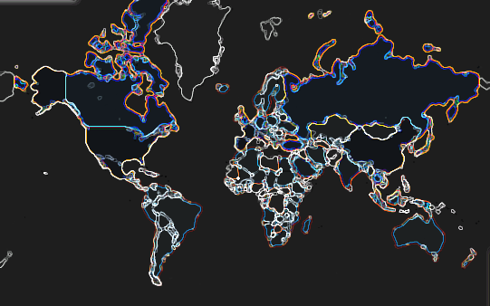
Members:
Solicia Xu
Ben Bastedo
Luis Casas
Project 2: International Traveler Arrival Data Visualization Dashboard

Slide 2
SCOPE OF PROJECT 2
Based on sourced travel information, visualize where tourist arrivals is more frequent on a micro (yearly) level, and infer how this impacts any given country’s economy by coupling with its corresponding GDP data
How do tourist arrivals in countries with higher GDP affect number of incoming passengers?
Is there a positive or negative correlation?
Is travel data for all countries accurately displayed from our datasets? What could cause some discrepancies?
Future Considerations and Limitations
Dashboard Components:
Python JavaScript Plotly PostgresSQL Flask | Zingchart.js NPM AnimateOnScroll CSS HTML

Slide 3
architecture design
Python
Data Source - CSV files from (step 1):
The World Bank: Number of International per Country Arrivals between 1995-2017: https://data.worldbank.org/indicator/ST.INT.ARVL?view=map
The World Bank: GDP growth per Country between 1995-2017: https://data.worldbank.org/indicator/NY.GDP.MKTP.CD
Coordinates (lat,long) coordinates for countries: https://developers.google.com/public-data/docs/canonical/countries_csv
Store data in DB (step 2):
Used PostGreSQL (PgAdmin) to generate database (TravelDb)
Merged country coordinates data with arrivals and gdp tables
Flask build (steps 3-5):
Set-up Flask to generate queries for 4 main routes:
Route(“/years”)
Route("/countries")
Route("/maps")
route("/apis")
Sub-routes:
"/arrivals"
"/countries"
"/latlngs"
"/years_arrival"
"/years_arrival_map"
"/years_gdp"
"/years_gdp_map”
Visualizations (step 6):
. Index:
Landing page with nav-bar.
By Country:
Two scatter plots showing incoming arrivals and GDP information for a certain country
Plotted using ZingChart
A World Map showing where the country is located on the map
Plotted using MapBox
By Year:
Two Choropleth plotyl maps used to show GDP and Arrivals per year for all countries
Animated Map View:
Two animated Plotly maps that show GDP per country and International arrivals by year using interactive sliders
API
JSON output HTML page that shows our datasets
Flask App
1. Read data from source
jsonify()
2. Store in persistent database
3. Query database
4. Expose data as JSON API
6. Visualize and deploy into web dashboard
5. Read JSON API using JavaScript
JavaScript, HTML, CSS
Notes:
Data url: https://www.google.com/imgres?imgurl=https%3A%2F%2Fcdn3.iconfinder.com%2Fdata%2Ficons%2Felastic-search-line%2F128%2FElastic_Search_-_Line-05-512.png&imgrefurl=https%3A%2F%2Fwww.iconfinder.com%2Ficons%2F4665701%2Fdata_data_source_database_elastic_search_search_data_icon&tbnid=dqN_fINWpMsvQM&vet=12ahUKEwi2xK-71sjnAhVGa6wKHXXYATEQMygAegUIARCBAg..i&docid=wfCWf4QNJdT3VM&w=512&h=512&q=data%20icon&ved=2ahUKEwi2xK-71sjnAhVGa6wKHXXYATEQMygAegUIARCBAg
Database: https://static.thenounproject.com/png/9658-200.png
Api: https://static.thenounproject.com/png/410844-200.png
Data preprocessing: https://cdn4.iconfinder.com/data/icons/internet-of-things-34/66/10-512.png
Javascript: https://cdn.iconscout.com/icon/free/png-256/javascript-20-555998.png
Data visualization: https://pngimage.net/wp-content/uploads/2018/06/graph-button-png-2.png

Slide 4
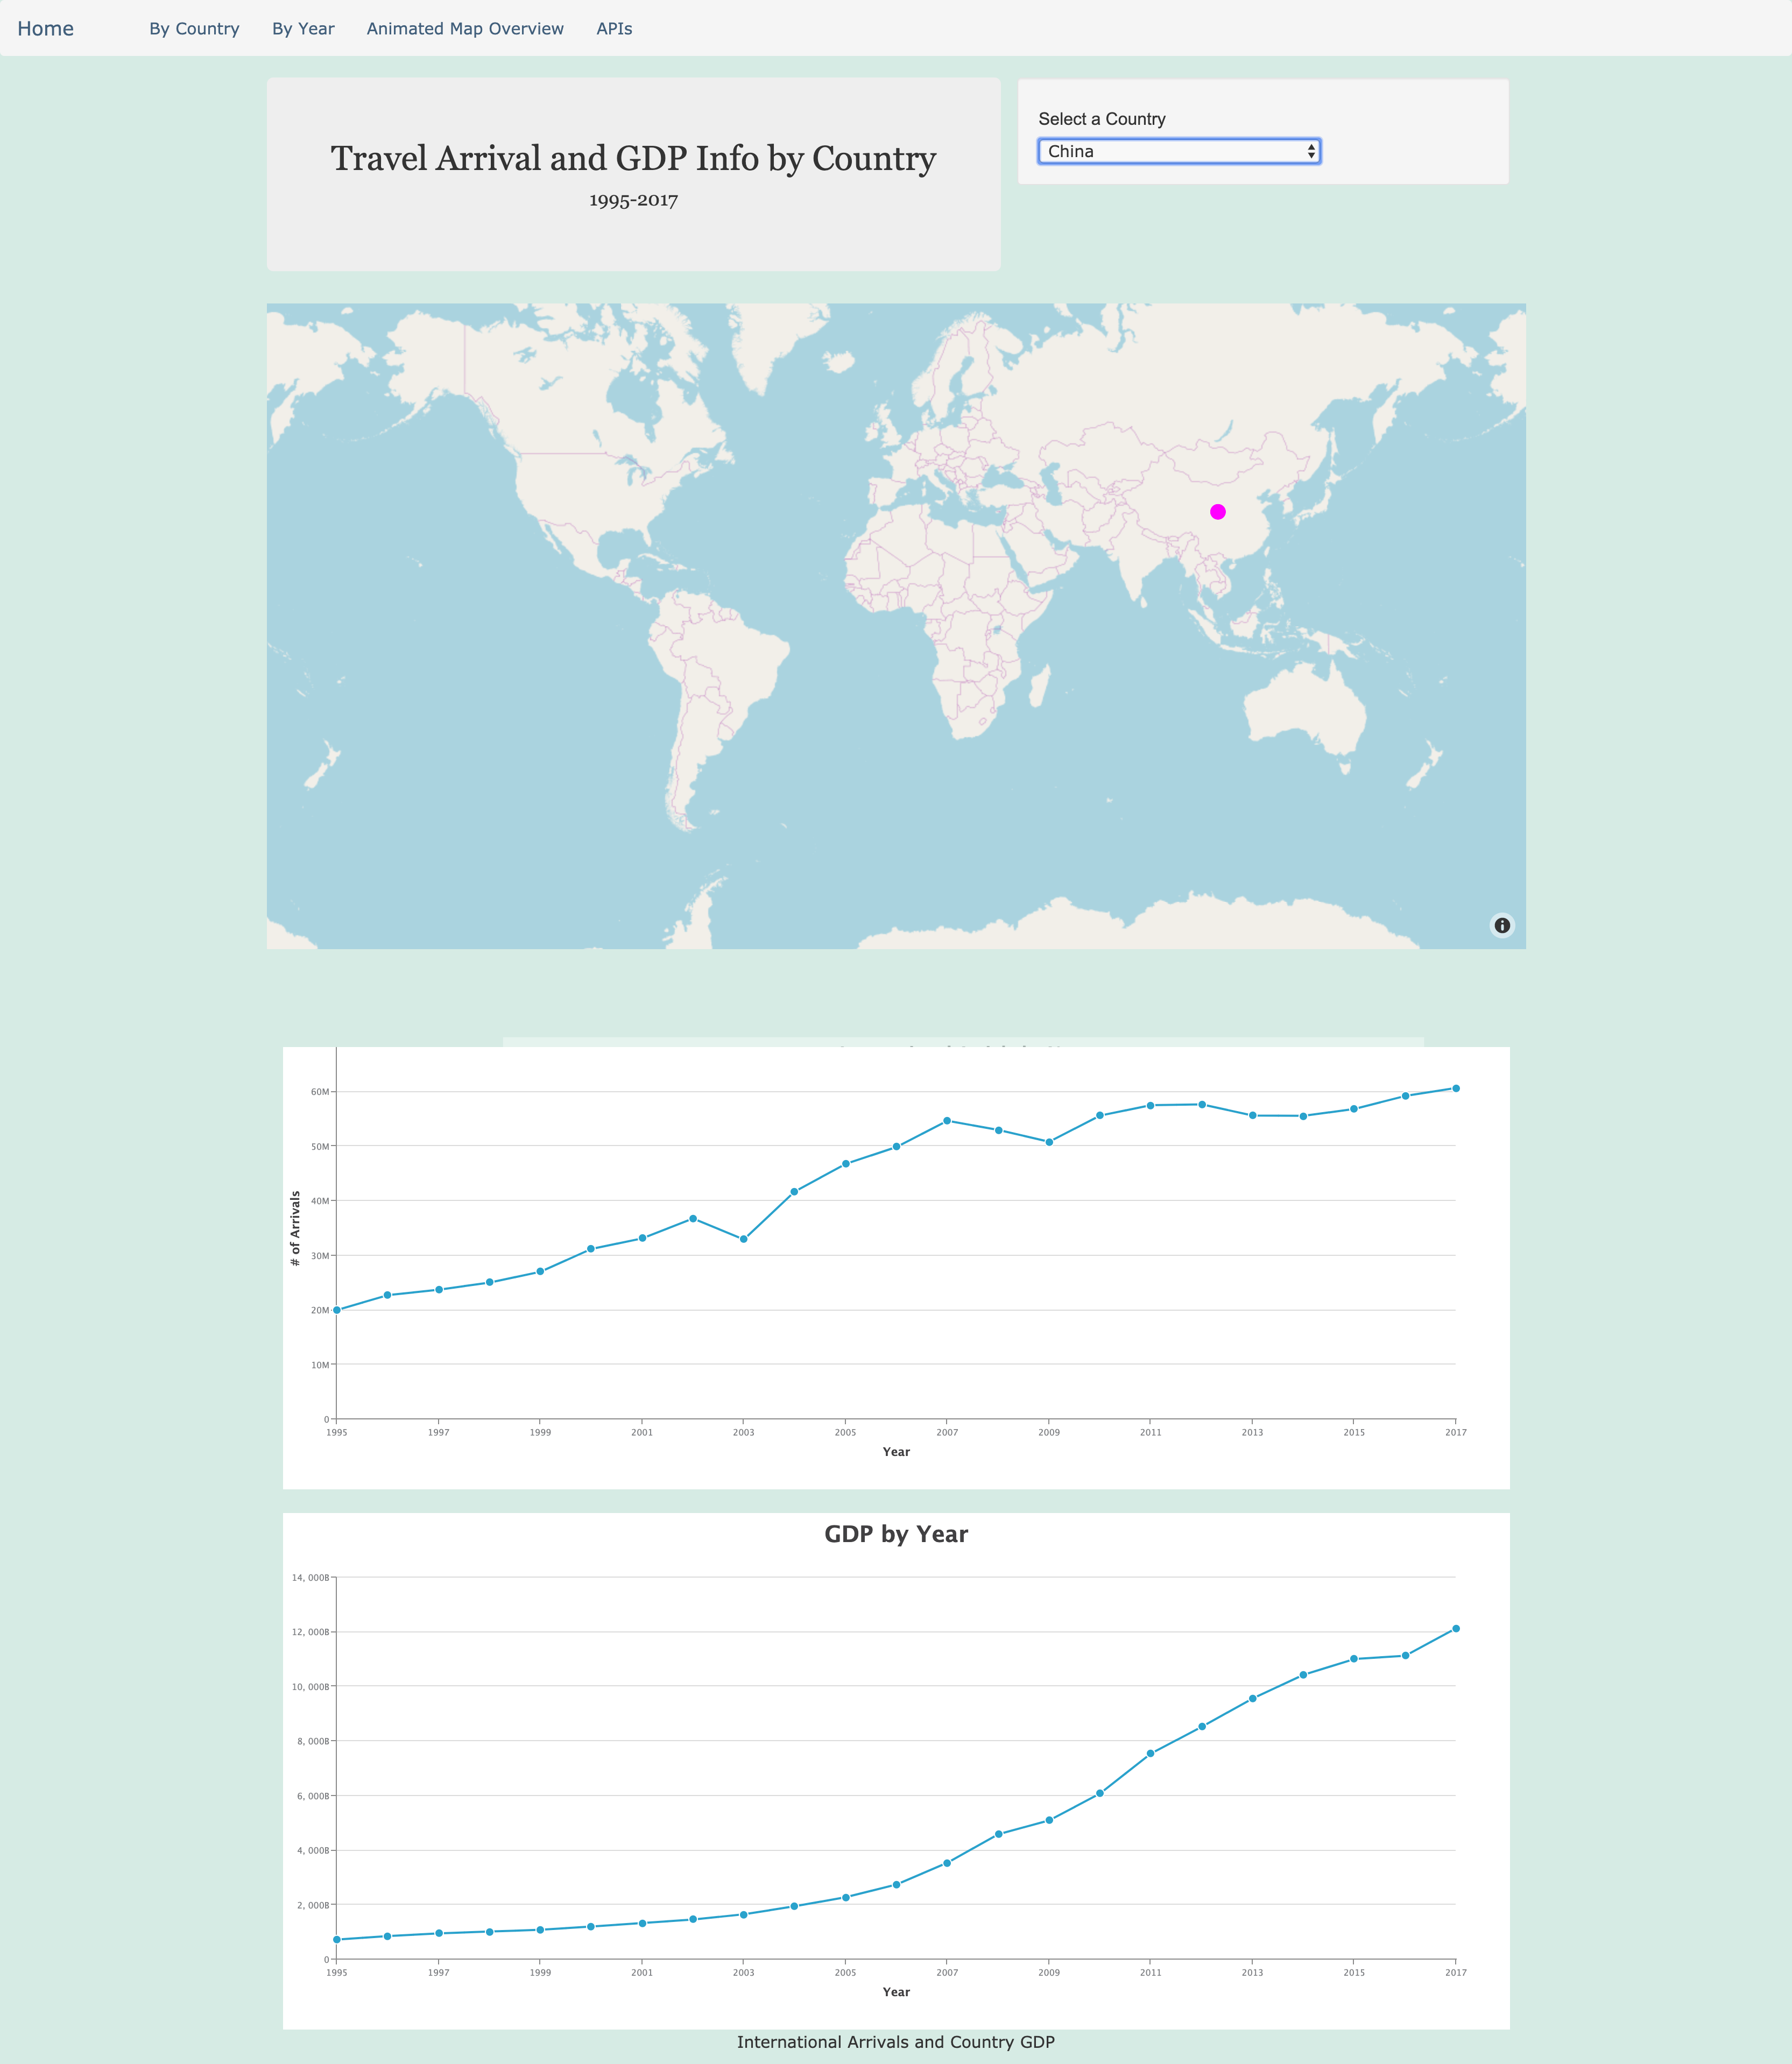
SNAPSHOT OF VISUALS IN PROJECT 2 – By Country

Slide 5
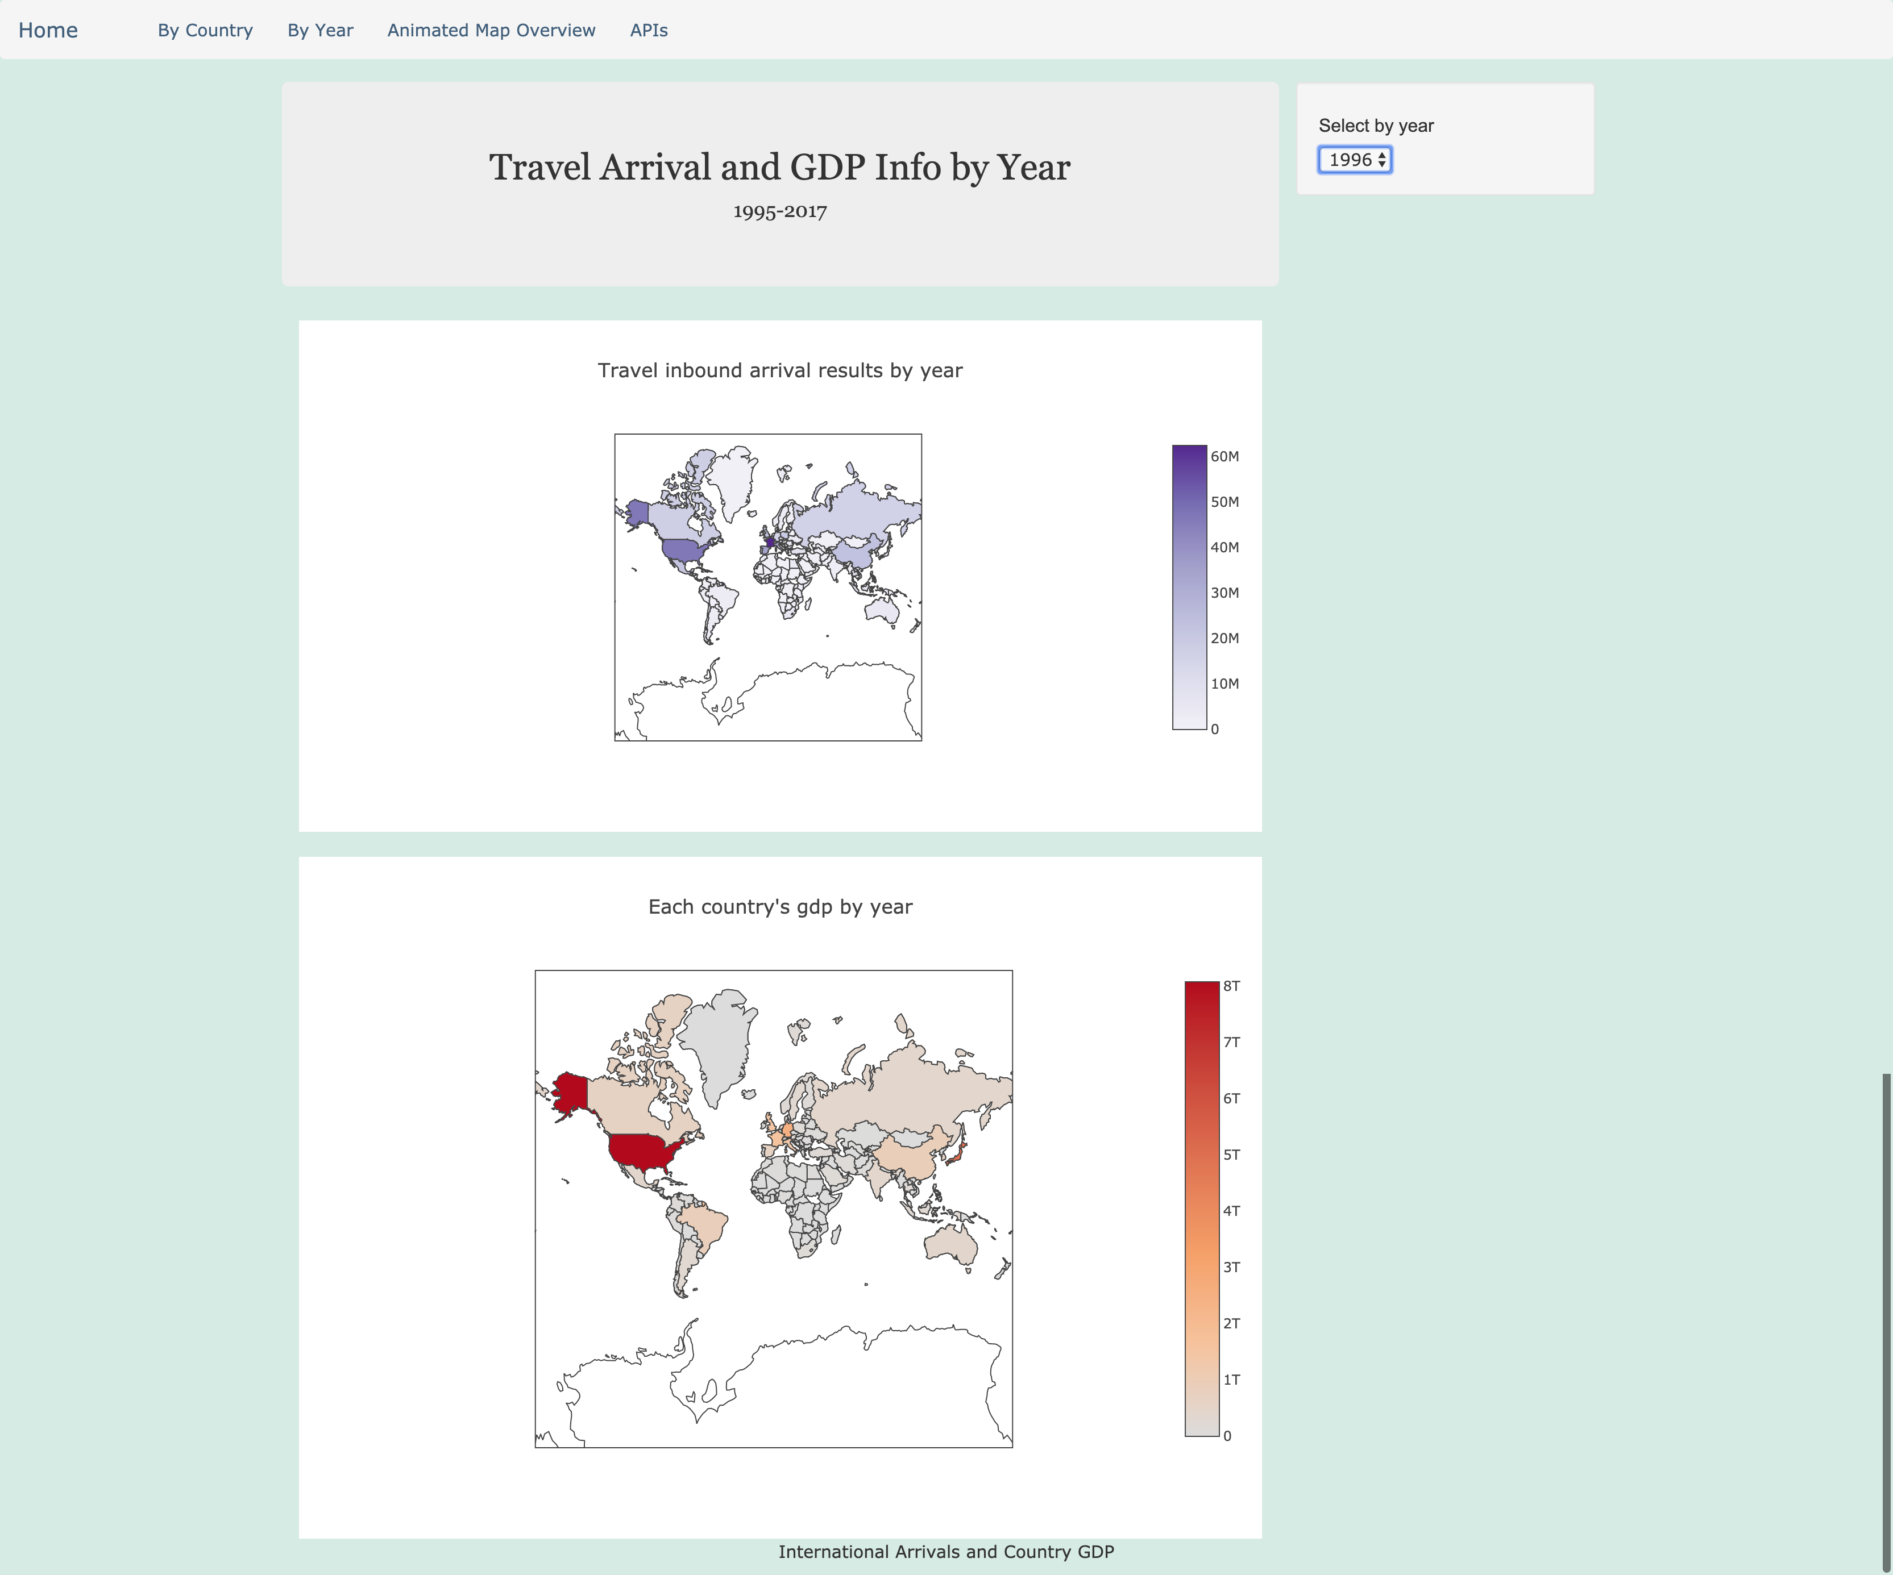
SNAPSHOT OF VISUALS IN PROJECT 2 – By Year

Slide 6
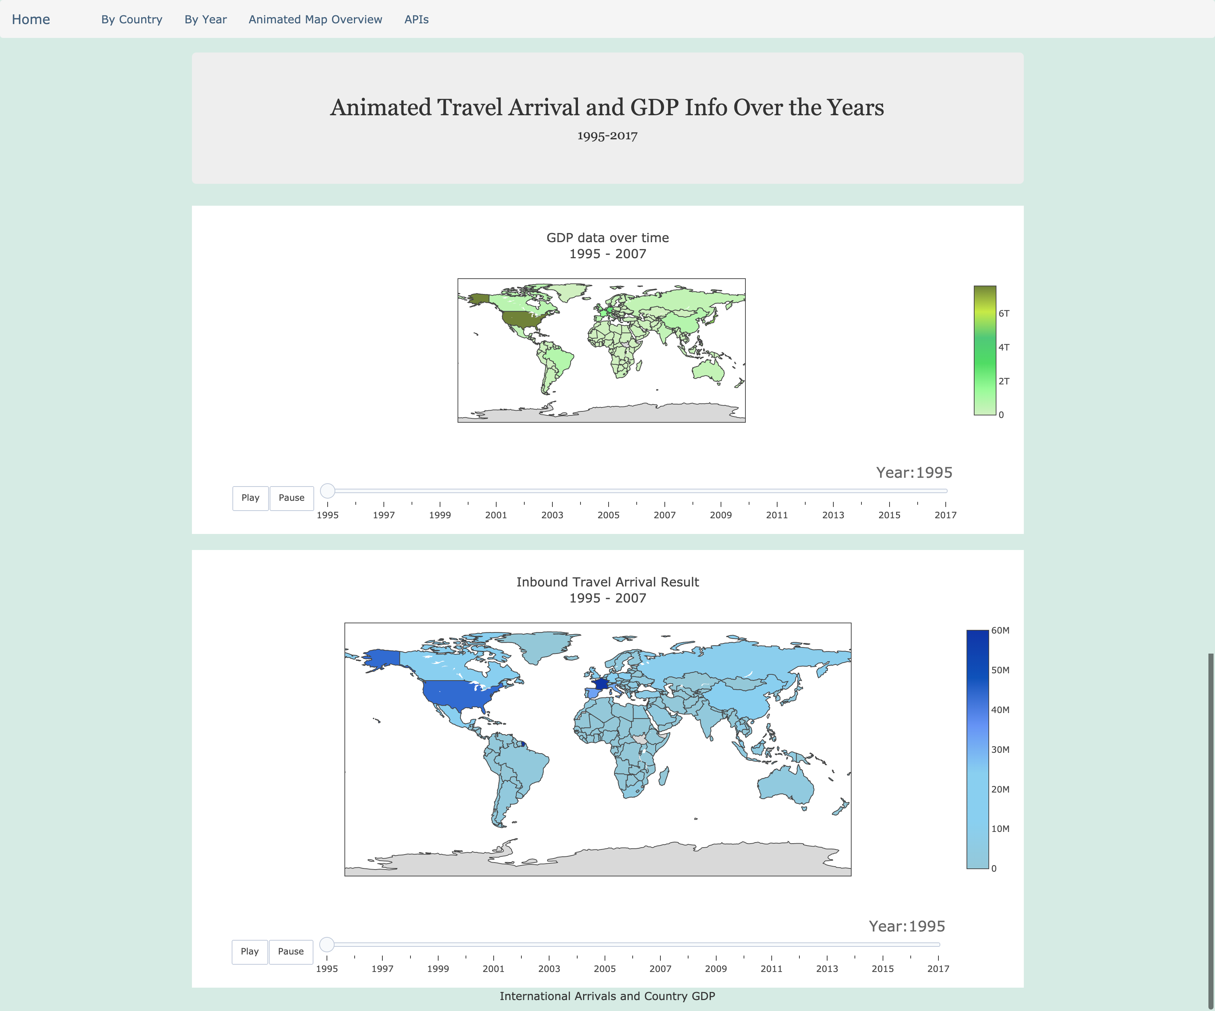
SNAPSHOT OF VISUALS IN PROJECT 2 – Animated Map View

Slide 7
Considerations/Limitations
AnimateOnScroll needs modification. Currently, in order to animate when scrolling, the window must be resized to activate the animations. Ideally, we would like to work this better.
Increase Bootstrap and HTML layout complexity.
Manipulate the year over year plots to show more visual data including population, poverty level, hotel bookings, rental car data, ride sharing information, public transit, etc.
Some countries did not have accurate data (Afghanistan) as they do not release international traveler data. Possibly identify new sources of data.
Host database on web server so that app can be run anywhere

